Slide 1
Dynamic Gaze-Contingent Rendering Complexity Scaling
By Luke Paireepinart

Slide 2
Initial Objectives
Use the eye sensitivity function
Dynamically adjust rendering complexity
Increase average frame rate
Make the degradation as unnoticeable as possible
Complete a real implementation in a single semester
Get extra credit points

Slide 3
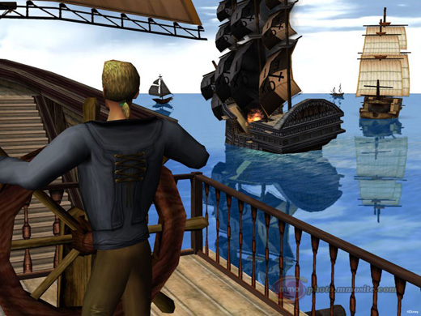

Project Implementation Environment

Slide 4
Panda3D justification
Made by Disney and CMU
Originally commercial, now Open-Source
Windows support
Commercial Applications & Games
Integrated w/ Python (vs. pyOGRE etc.)
Extremely fast engine
But most of all…..

Slide 5




Shader Support with
CG vs. HLSL vs. GLSL
Shaders are really neat

Slide 6
Shader Pipeline
Vertex Shader
Modifies vertex positions, as well as colors / texcoords (which are LERP’ed)
Geometry Shader
Creates new vertexes
Pixel / Fragment Shader
Determines final rendering color of every pixel

Slide 7
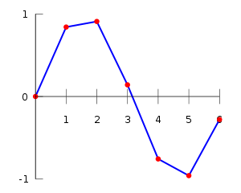
What the heck is LERP?!
Linear IntERPolation

Slide 8
Shader Complexity
Vertex Shader Speed
Determined by the number of visible (basically) vertexes in the scene
Fragment Shader Speed
Run for every pixel on the screen (for specific models w/ fragment shaders applied)

Slide 9
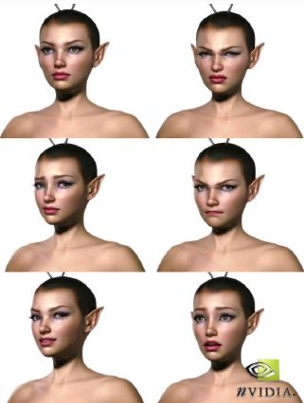
Example Vertex Shaders

Slide 10
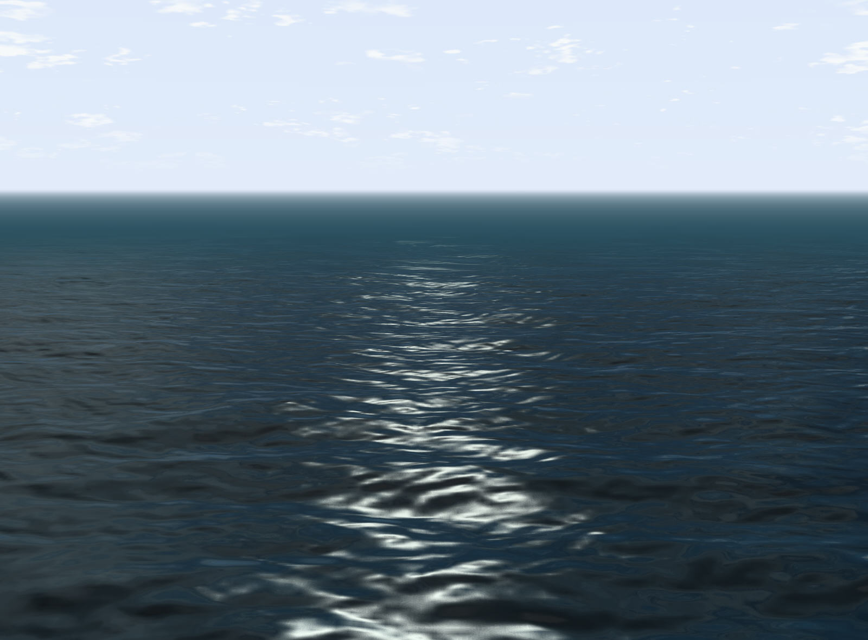
Example Vertex Shaders

Slide 11

Example Geometry Shaders

Slide 12
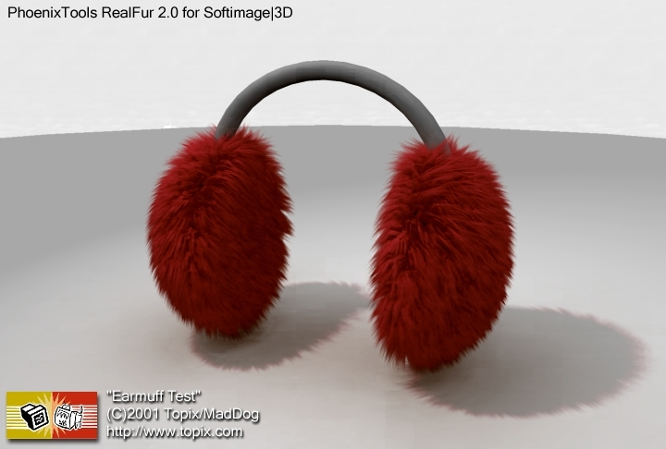
Example Geometry Shaders

Slide 13
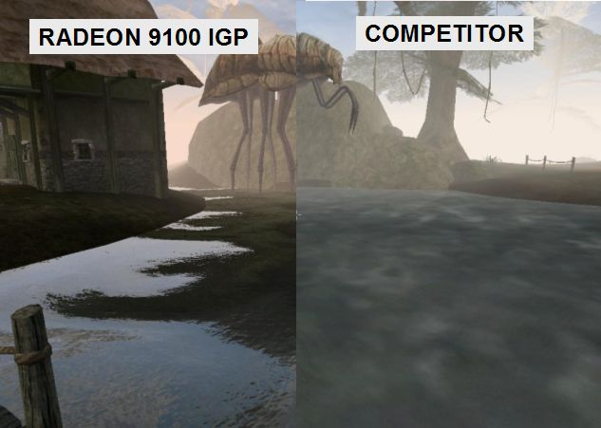
Example Pixel Shaders

Slide 14
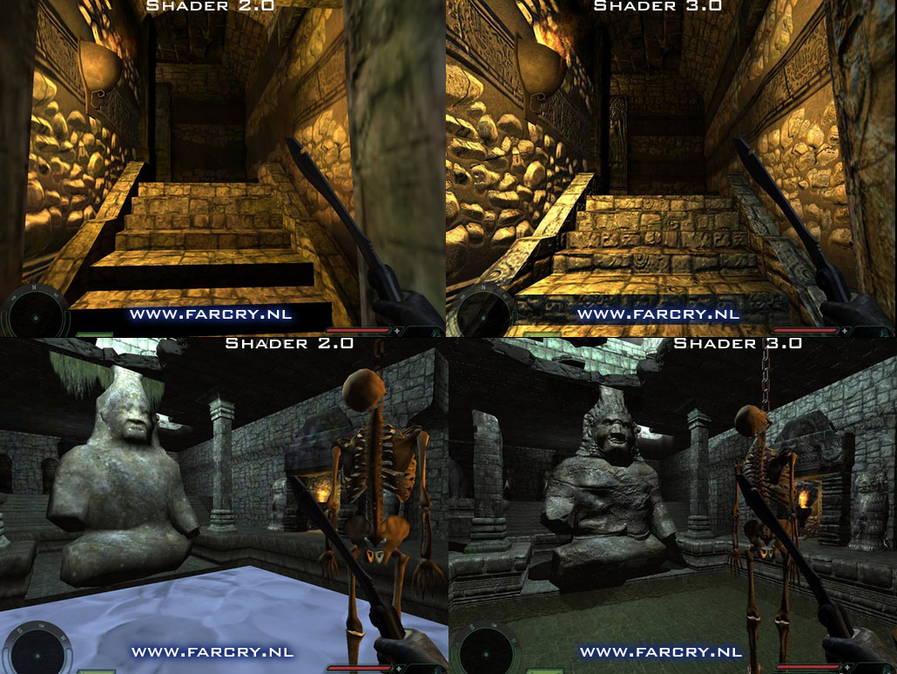
Example Pixel Shaders

Slide 15
How ridiculously fast the GPU is
1680x1050 display = 1,764,000 pixels on screen,
1920x1200 display = 2,304,000 pixels on screen!
Can have multiple fragment shaders per pixel
8800GT runs my shader at ~700 FPS at 1680x1050
That’s 1,234,800,000 function calls a second!
The 9800GT = $85 new on Newegg
9800GT == 8800GT (they are EXACTLY the same card)

Slide 16
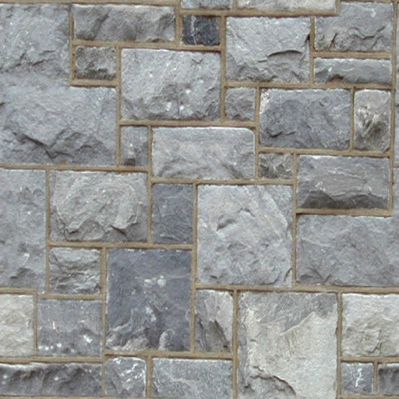
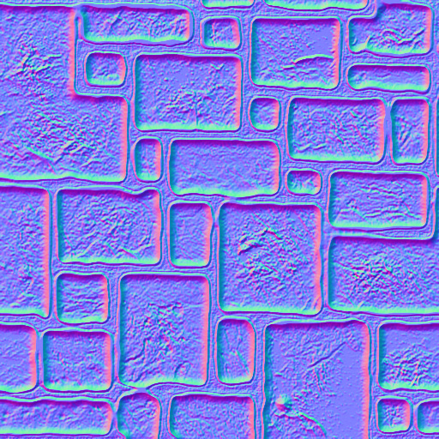
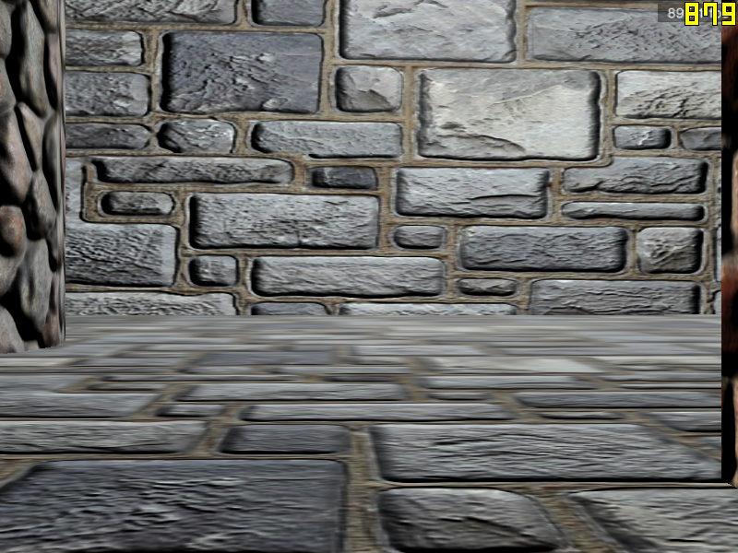
Bump Mapping
+ =

Slide 17
No Live Demonstration
Laptop doesn’t support shaders
Panda3D can’t be installed on school computers
Desktop is enormous & I don’t want to carry it
Screenshots/video will have to do
I’ll send you the program later if you’re interested and you ask nicely

Slide 18
Actual Running Example

Slide 19
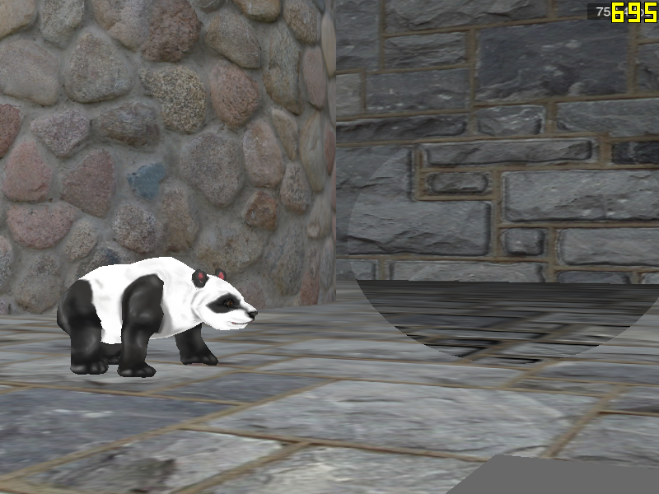
Actual Running Example

Slide 20
Actual Running Example
Youtube Video
It’s much smoother in real life
(recorded at 60 FPS, encoded at 29.97 FPS, result… judder)

Slide 21
Approach Justification
Bump-mapping is a simple example, but…
Shader is reusable
Modifications are easy
Template could be created
Could be integrated into every pixel shader automatically by engine
Could be integrated into vertex / geometry shaders as well

Slide 22
Deviation from Spec
Render stops at a specific point (no sensitivity function, just a hard drop-off)
vs
No speed gain in areas where rendering is done partially (for most effects)

Slide 23
Idealistic Goals
Great speedup
Unnoticeable degradation of effect
Easy implementation
Everyone’s happy!

Slide 24
Unfortunate Reality
Branching in GPU code is not implemented well
If your code follows two different branches it is not optimized correctly by the compiler, and automatically gets slowed down by about 8%
Even with identical code in both branches, there was still that 8% slowdown if the branch was taken only during certain calls
This may be due to a cache miss, but seems unlikely

Slide 25
Unfortunate Reality
Bumpmapping creates contrast
Lack of contrast in peripheral is still noticeable
It’s not necessarily distracting but the effect is not as seamless as you might wish
Updating mouse position creates massive slowdown while mouse is moving
Still was >400FPS in the example with mouse waving
Notes:
Using less aggressive darkening on the bump mapping will likely alleviate both of the bumpmapping issues

Slide 26
Unfortunate Reality
CG REALLY SUCKS
Variable passing is not implemented in a sensible manner
Certain variables have to be copied to a new variable and re-aliased before they’re passed
Even just ACCESSING the wrong variable can cause everything to break
NO REALLY, check it out…

Slide 27
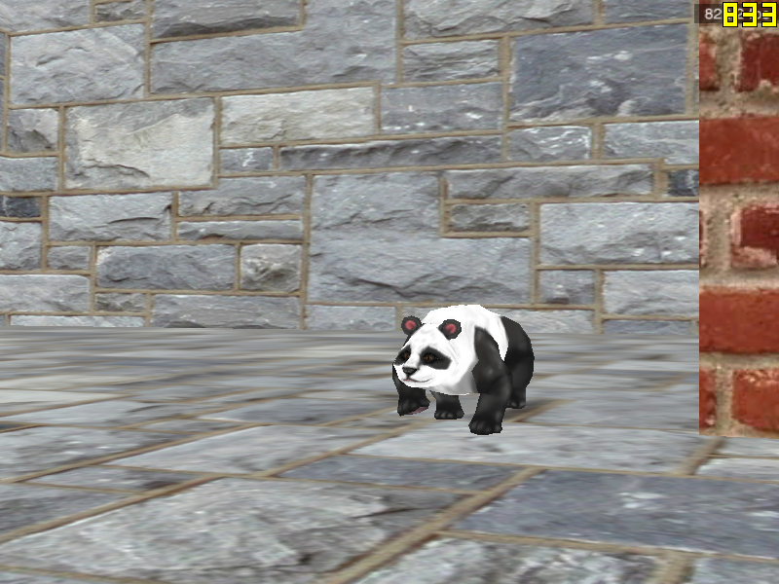
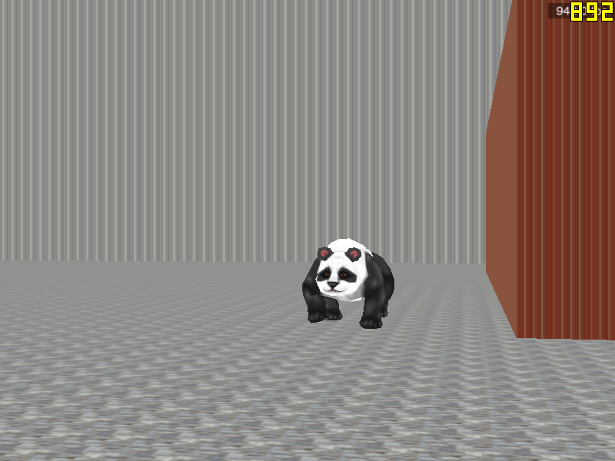
CG Sucks Passthrough Fragment Shader
Commented variable access
Uncommented variable access
//l_position;
o_color = tex2D(tex_0, l_texcoord0);
o_color.w = 1.0;
l_position;
o_color = tex2D(tex_0, l_texcoord0);
o_color.w = 1.0;

Slide 28
Actual Performance Characteristics
During regular run at 1680x1050 (windowed)
700-730 FPS with full-screen bumpmapping
650-700 FPS with area bumpmapping
During regular run at 1680x1050 (fullscreen)
Exactly the same as above results
Yeah, I thought fullscreen would be faster too
I ran it on Windows XP. On Win7, windowed mode is automatically VSYNCed so FPS would be 60 (for my monitors (and probably yours too))

Slide 29
How we could make this actually speed up rendering process
GPU branching needs to be made more efficient
Use effects that are so complicated to calculate that the speed improvement is worth the branching slowdown
Modify specific effects to be scaled without a branch (using the distance from center directly)
But this solution is not as universal as the original and relies on the implementer too much

Slide 31
Other ways to speed up games
Dynamic model complexity scaling
This would be implemented in the engine, not shaders
Vertex Shader scaling
This is a logical progression from the pixel shader approach and is essentially identical
Geometry Shader scaling
Same as above
Notes:
Dynamic scaling would use the game engine itself to determine model scaling, not the shaders

Slide 32
Fragment Shader definition
void fshader(float4 l_position : POSITION,
float4 l_my_position: TEXCOORD0,
float2 l_texcoord0,
float3 l_lightvec,
float3 l_pointpos,
uniform float4 k_mousepos: C6,
uniform float4 mspos_light : C7,
sampler2D tex_0,
sampler2D tex_1,
out float4 o_color : COLOR)

Slide 33
Fragment Shader implementation
// “point” is the location of the pixel itself on the screen
float2 point = float2(l_my_position[0]/l_my_position[3],l_my_position[1]/l_my_position[3]);
// “point2” is the location of the mouse on the screen
float2 point2 = float2(k_mousepos[0], k_mousepos[1]);
// in_area determines if the position of the pixel is within x distance of the mouse.
// k_mousepos[2] is actually a flag for enabling/disabling the effect.
bool in_area = (k_mousepos[2] > .9 && distance(point, point2) < .5) || k_mousepos[2] < .1;
// everything will be white if it’s in the center and white otherwise.
if (in_area)
o_color = float4(1,1,1,1);
else
o_color = float4(0,0,0,1);

Slide 34
The End

